Slide 1


Food Allergy Training
The Ultimate Overview

Slide 2


Meet Ally
Allison Rose Suhy

Slide 3











Medical Advisory Board
Dr. Lisa Bartnikus
Boston Children’s Hospital
Dr. Ruchi Gupta
Lurie Children’s Hospital
Dr. Alice Hoyt
Coda Ana
Dr. Sandra Hong
Cleveland Clinic
Dr. Katie Marks-Cogan
Clear Allergy
Dr. Princess Ogbogu
University Hospital
Dr. Brian Schroer
Cleveland Clinic
Dr. Ruchi Shah
Cleveland Clinic
Dr. Julie Sterbank
MetroHealth
Dr. David Stukus
Nationwide Children’s Hospital

Slide 4
Code Ana
•This training was developed in collaboration with Code Ana.
•Code Ana is a non-profit program designed by board-certified, allergist Dr. Alice Hoyt.
•Code Ana equips schools to be prepared for medical emergencies like anaphylaxis through evidence-based medical information and innovative, school-tailored medical response planning.
•Code Ana developed our allergist driven train the trainer program for our medical professionals.
DISCLAIMER: The information provided here is for educational purposes only and is not intended to replace the medical advice of a doctor or healthcare provider. If you think you are observing a medical emergency such as but not limited to a food allergic reaction, call 911 immediately.

Slide 5
Key Points
  Anaphylaxis is a severe allergic reaction, and recognition is the first step to an effective response.
  Anaphylaxis is treated with epinephrine (Epi Pen, Auvi-Q, Neffy).
  This training will help prevent and prepare you for anaphylaxis.

Slide 6
An Epidemic
More than 33 million Americans live with food allergies.
1 in 13 children in the U.S. live with a food allergy.
1 in 5 children with a food allergy have a reaction in school, and many young adults with food allergy do not freely share that they have food allergies.
Restaurants/dining away from home are the second most common location for a food allergic reaction, and many individuals with food allergy do not freely share that they have food allergies.
Not recognizing a food allergy reaction—delaying treatment—is a risk factor for death.
Teenagers and young adults with food allergies are at the highest risk of fatal food-induced allergic reactions.

Slide 7
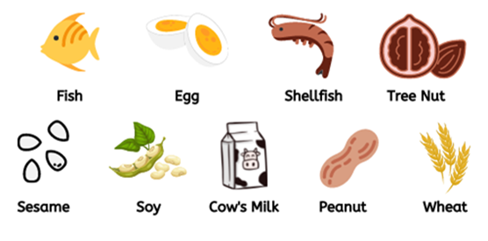
Allergy? Or Intolerance?
Sudden-Onset Hives, Swelling,
Trouble Breathing, Vomiting?
Likely Food Allergy

Slide 8


Allergy? Or Intolerance?
Sudden-Onset Hives, Swelling,
Trouble Breathing, Vomiting?
Headache, Digestive Distress,
Brain Fog?
Likely Food Allergy
Likely Food Intolerance

Slide 9
Allergy? Or Intolerance?
Sudden-Onset Hives, Swelling,
Trouble Breathing, Vomiting?
Headache, Digestive Distress,
Brain Fog?
Likely Food Allergy
Likely Food Intolerance
Key Differences
1. Treatment: Food allergy reactions are treated with epinephrine. Food intolerances are treated with over-the-counter medications.
2. Severity: Food allergy reactions are life threatening. Food intolerances are uncomfortable but not life threatening.

Slide 10
What Really is Anaphylaxis?
  Anaphylaxis is a severe allergic reaction.
  Anaphylaxis may start as “just hives” but then progress to involve breathing trouble and even death.
  Anaphylaxis should be treated promptly with epinephrine.

Slide 11



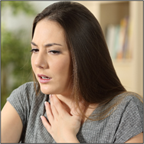

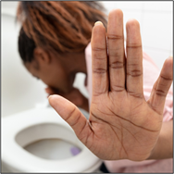
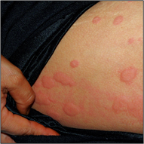
Symptoms of Anaphylaxis
Altered mental status
Feeling Faint
Loss of Consciousness
(due to low blood pressure)
Sudden-onset upper
respiratory congestion
Sneezing
Coughing
Trouble breathing
Wheezing
Swelling anywhere
especially face
Sudden-onset
Nausea/upset stomach
Vomiting
Diarrhea
Hives anywhere on
body

Slide 12
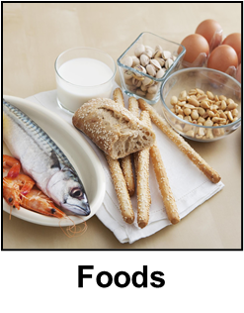
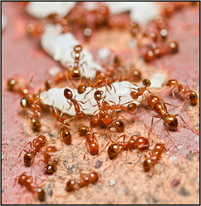

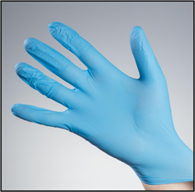


Causes of Anaphylaxis
Foods
Venomous Insects
Latex
Medications
Exercise

Slide 13
Treatment for Anaphylaxis
EPINEPHRINE
Epinephrine is the only medication that STOPS the allergic reaction.
Antihistamines (i.e. Benadryl) do NOT STOP the allergic reaction.

Slide 14
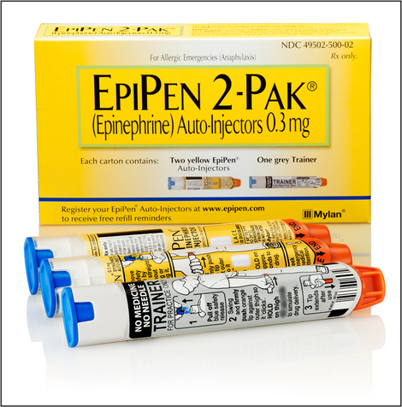
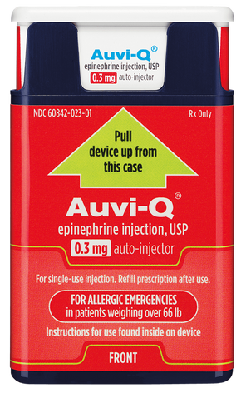
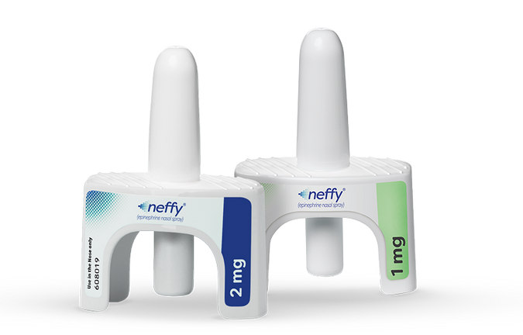
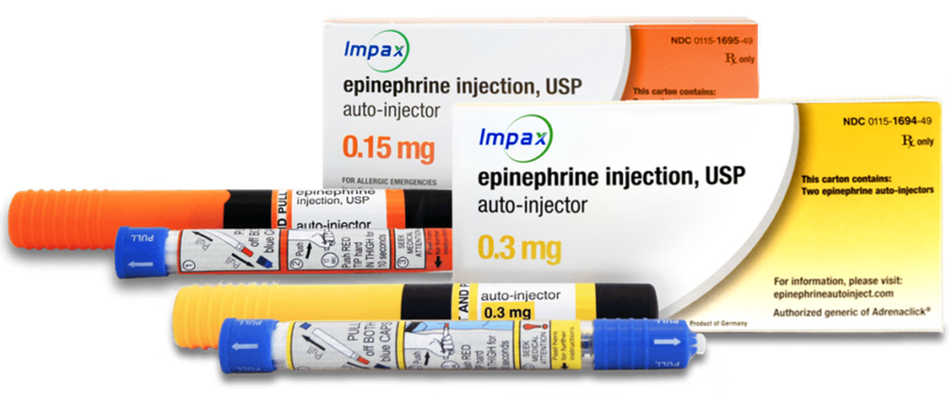
Epinephrine Devices
Auto-Injectors
Nasal Spray

Slide 15
How To Use an
Epinephrine Auto-Injector
Step 1: Remove device from case.
Step 2: Remove safety cap(s).
Step 3: Apply device to upper outer thigh, then apply firm pressure.
Step 4: Hold device in place for 2-10 seconds (depends on device).
Step 5: Call 911. Repeat 1-4 if no improvement in 3-5 minutes.
Key Points
1. Person having reaction should lay down. Ideally, legs should be elevated.
2. Epinephrine auto-injectors can be given THROUGH clothing.
3. 911 should ALWAYS be called when epinephrine is administered.

Slide 16
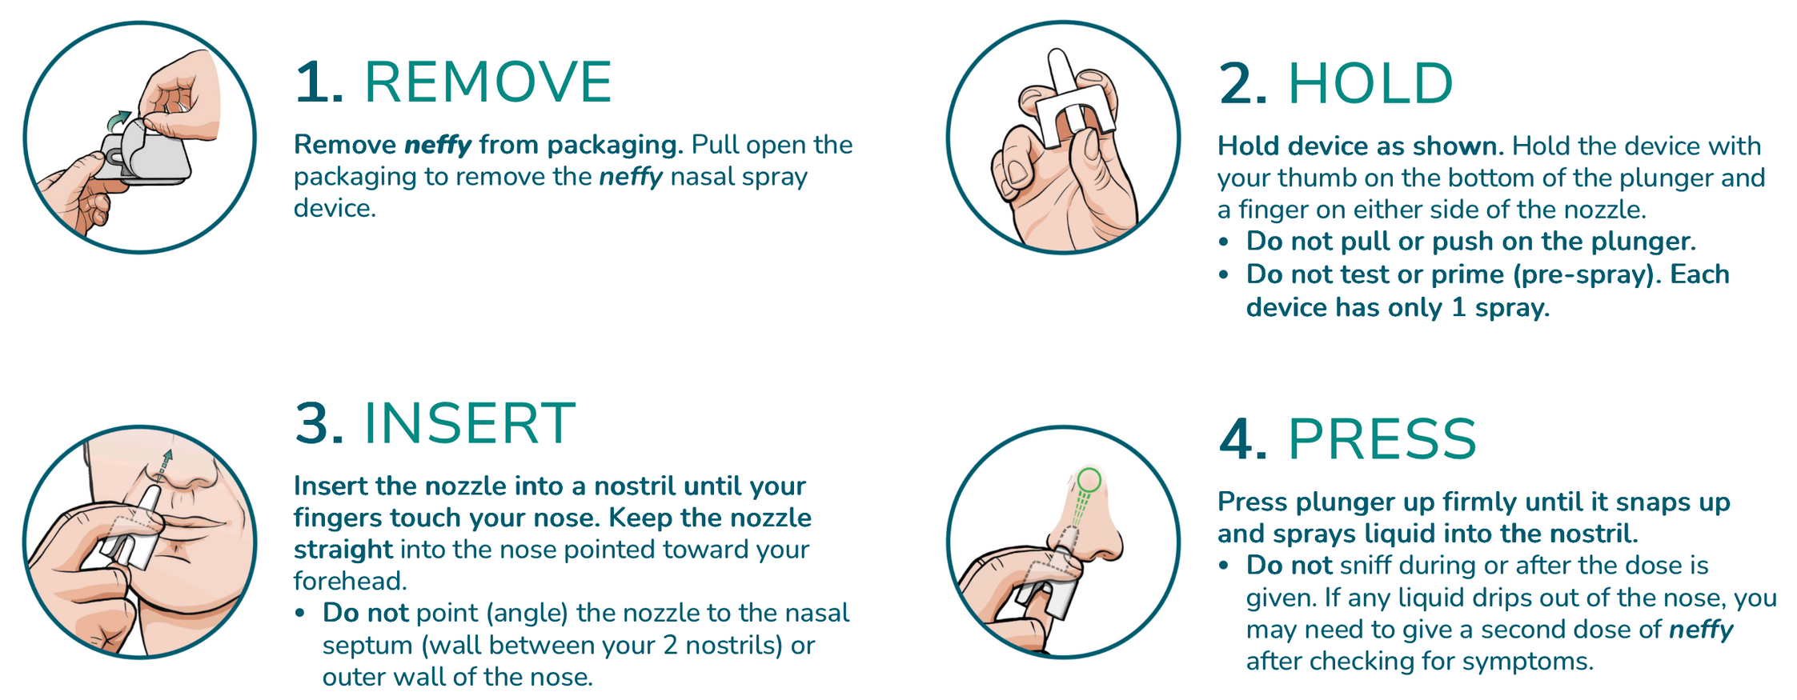
How To Use an
Epinephrine Nasal Spray

Slide 17
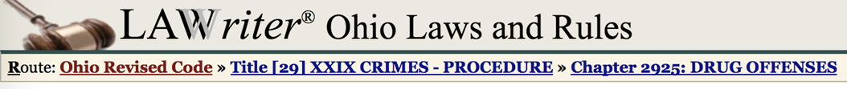
Law in Ohio
2925.64 Immunity for administering epinephrine.
(A) As used in this section:
(1) "Administer epinephrine" means to inject an individual with epinephrine using an autoinjector in a manufactured dosage form.
(2) "Prescriber" and "qualified entity" have the same meanings as in section 3728.01 of the Revised Code.
(B) An individual or qualified entity is not subject to criminal prosecution for a violation of section 4731.41 of the Revised Code or criminal prosecution under this chapter if the individual or entity, acting in good faith and in accordance with Chapter 3728. of the Revised Code, administers epinephrine or provides an epinephrine autoinjector to an individual who appears to be experiencing or at risk of experiencing anaphylaxis or to the parent, guardian, or custodian of such an individual.

Slide 18
Law in Ohio
“Allison Rose Act”
Encourages school districts, community and STEM schools to create food allergy training for staff members and students.
This training will qualify as a professional development activity for the renewal of educator licenses. In addition, it helps individuals identify and respond to someone experiencing an allergic reaction.
Requires the Ohio Department of Education (ODE) to compile an annual list of organizations who offer free epinephrine devices to qualifying school districts.

Slide 19
COMMON QUESTIONS

Slide 20
Risk of Death
Which of the following increases the risk of death due to anaphylaxis?
A. Delayed administration of epinephrine
B. Asthma
C. Being a young adult
D. Type of food allergen
E. All of the above

Slide 21
Risk of Death
Which of the following increases the risk of death due to anaphylaxis?
A. Delayed administration of epinephrine
B. Asthma
C. Being a young adult
D. Type of food allergen
E. All of the above
A-D are associated with increased risk of BAD OUTCOMES.
A: Delaying treatment = worsening reaction = more difficult to treat.
B: Asthma attacks can be triggered by anaphylaxis and, because this involves the airway, is more likely to result in death.
C: Young adults may not always make ideal choices, but they also have robust immune systems that, when activated, can be difficult to stop. Also, alcohol and meds like Motrin (“NSAIDs”) increase the risk of anaphylaxis upon allergen exposure.
D: Some allergens, such as peanuts, are associated with death more so than other allergens.

Slide 22
Other Treatments
Which of the following are treatments for anaphylaxis?
A. Taking a cold drink of water
B. Taking deep breaths
C. Going outside into fresh air
D. Antihistamines, like Benadryl
E. Blowing cold air on their face
F. Cough medicine
G. “Sucking it up”
H. None of the above

Slide 23
Other Treatments
Which of the following are treatments for anaphylaxis?
A. Taking a cold drink of water
B. Taking deep breaths
C. Going outside into fresh air
D. Antihistamines, like Benadryl
E. Blowing cold air on their face
F. Cough medicine
G. “Sucking it up”
H. None of the above
•Epinephrine, not antihistamines, treat the signs and symptoms of anaphylaxis.
•A-G do not and relying on treatment options A-G will result in DELAYED administration of epinephrine, which results in WORSE outcomes.

Slide 24
True or False

Slide 25
Benadryl
True or false: Benadryl is a treatment for anaphylaxis.
A. True
B. False

Slide 26
Benadryl
True or false: Benadryl is a treatment for anaphylaxis.
A. True
B. False
• Benadryl does not stop allergy cells from releasing the chemicals that cause the symptoms of anaphylaxis.
• Only epinephrine stops allergy cells.
• Benadryl also does not help fix low blood pressure or trouble breathing. Epinephrine DOES.

Slide 27
One Bite
True or false: One bite of an allergen could be fatal.
A. True
B. False

Slide 28
One Bite
True or false: One bite of an allergen could be fatal.
A. True
B. False
• Even microgram amounts of allergens can cause fatal reactions.
• If a person is allergic, strict avoidance is important.

Slide 29
Proximity
True or false: A person with a food allergy cannot be in the same room with his/her allergen because close proximity even without eating it could cause an anaphylactic reaction.
A. True
B. False

Slide 30
Proximity
True or false: A person with a food allergy cannot be in the same room with his/her allergen because close proximity even without eating it could cause an anaphylactic reaction.
A. True
B. False
•Allergic reactions to foods are triggered when a person with the food allergy eats - “ingests” the food to which s/he is allergic.
•Looking at the food will not cause an allergic reaction.
•Smelling the food will not cause an allergic reaction.

Slide 31
Epinephrine #1
True or false: An individual who is trained in how to administer epinephrine and who, in good faith, recognizes and treats anaphylaxis with epinephrine, may be held liable if there is a bad outcome.
A. True
B. False

Slide 32
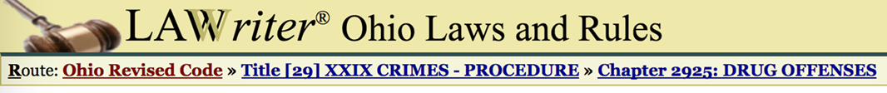
Epinephrine #1
True or false: An individual who is trained in how to administer epinephrine and who, in good faith, recognizes and treats anaphylaxis with epinephrine, may be held liable if there is a bad outcome.
A. True
B. False
An individual or qualified entity is not subject to criminal prosecution for a violation of section 4731.41 of the Revised Code or criminal prosecution under this chapter if the individual or entity, acting in good faith and in accordance with Chapter 3728. of the Revised Code, administers epinephrine

Slide 33
Epinephrine #2
True or false: If epinephrine is used, call 9-1-1.
A. True
B. False

Slide 34
Epinephrine #2
True or false: If epinephrine is used, call 9-1-1.
A. True
B. False
•Epinephrine treats the life-threatening reaction ANAPHYLAXIS. Multiple doses may be required.
•ANAPHYLAXIS is dangerous and requires immediate medical attention, even if symptoms are improving.
•A person experiencing anaphylaxis needs to be treated with epinephrine and call 9-1-1, not because epinephrine is dangerous (it is not) but because anaphylaxis is dangerous.

Slide 35
Epinephrine #3
True or false: Epinephrine should only be administered for anaphylaxis in a person with a known diagnosis of food allergy.
A. True
B. False

Slide 36
Epinephrine #3
True or false: Epinephrine should only be administered for anaphylaxis in a person with a known diagnosis of food allergy.
A. True
B. False
In 24% of at-school episodes of anaphylaxis, the individual is not known to have a life-threatening allergy.
Only about half of the customers who had a reaction (53.9 percent) informed restaurant staff beforehand about the allergy.
Many individuals do not readily share their food allergy status.
Epinephrine is very safe!

Slide 37
Be Prepared
Discuss risks for exposure
  Discuss risks for exposure
  Cross-contact
  Dating
  Dining out/if serving food ask about food allergies
  Reading /understanding food labels
  Baked goods from home, know ingredients
Ask and tell about prior reactions
Know who in your circle of friends or co-workers are at risk for food allergy emergencies
Emergency action plan
      Epi
      911
      Supportive care

Slide 38
Be Prepared!
Know who in your place of work or organization is at risk for medical emergencies like anaphylaxis.
Educate others to recognize and respond to food allergy emergencies.
Know your organization’s policies.
  Food policies
  Cleaning protocols

Slide 39
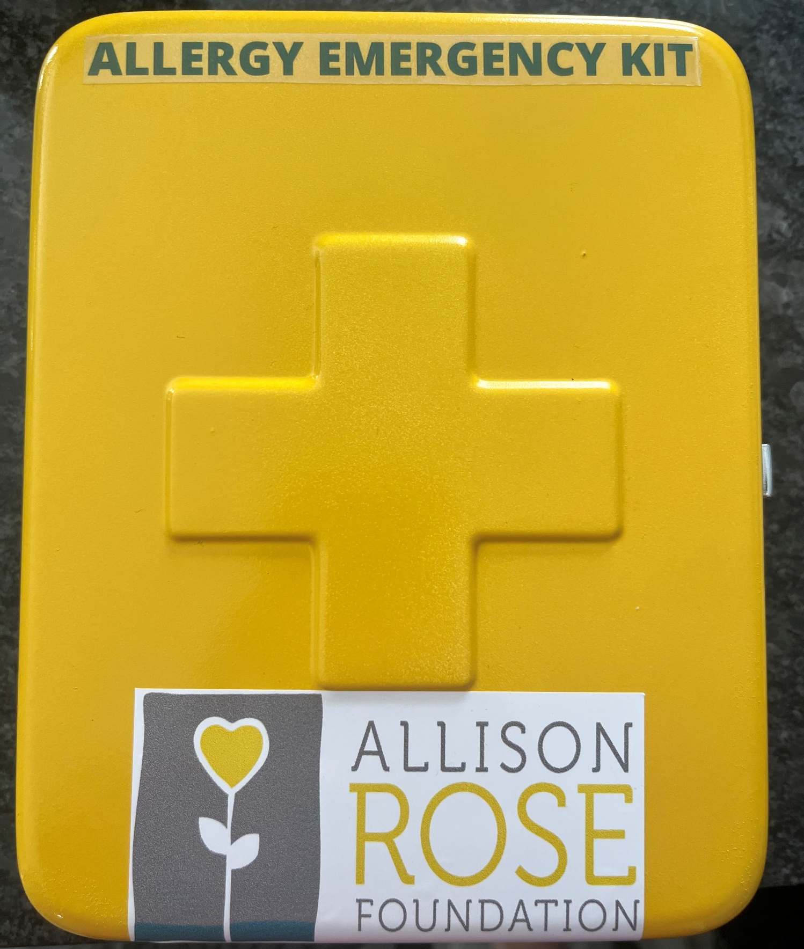
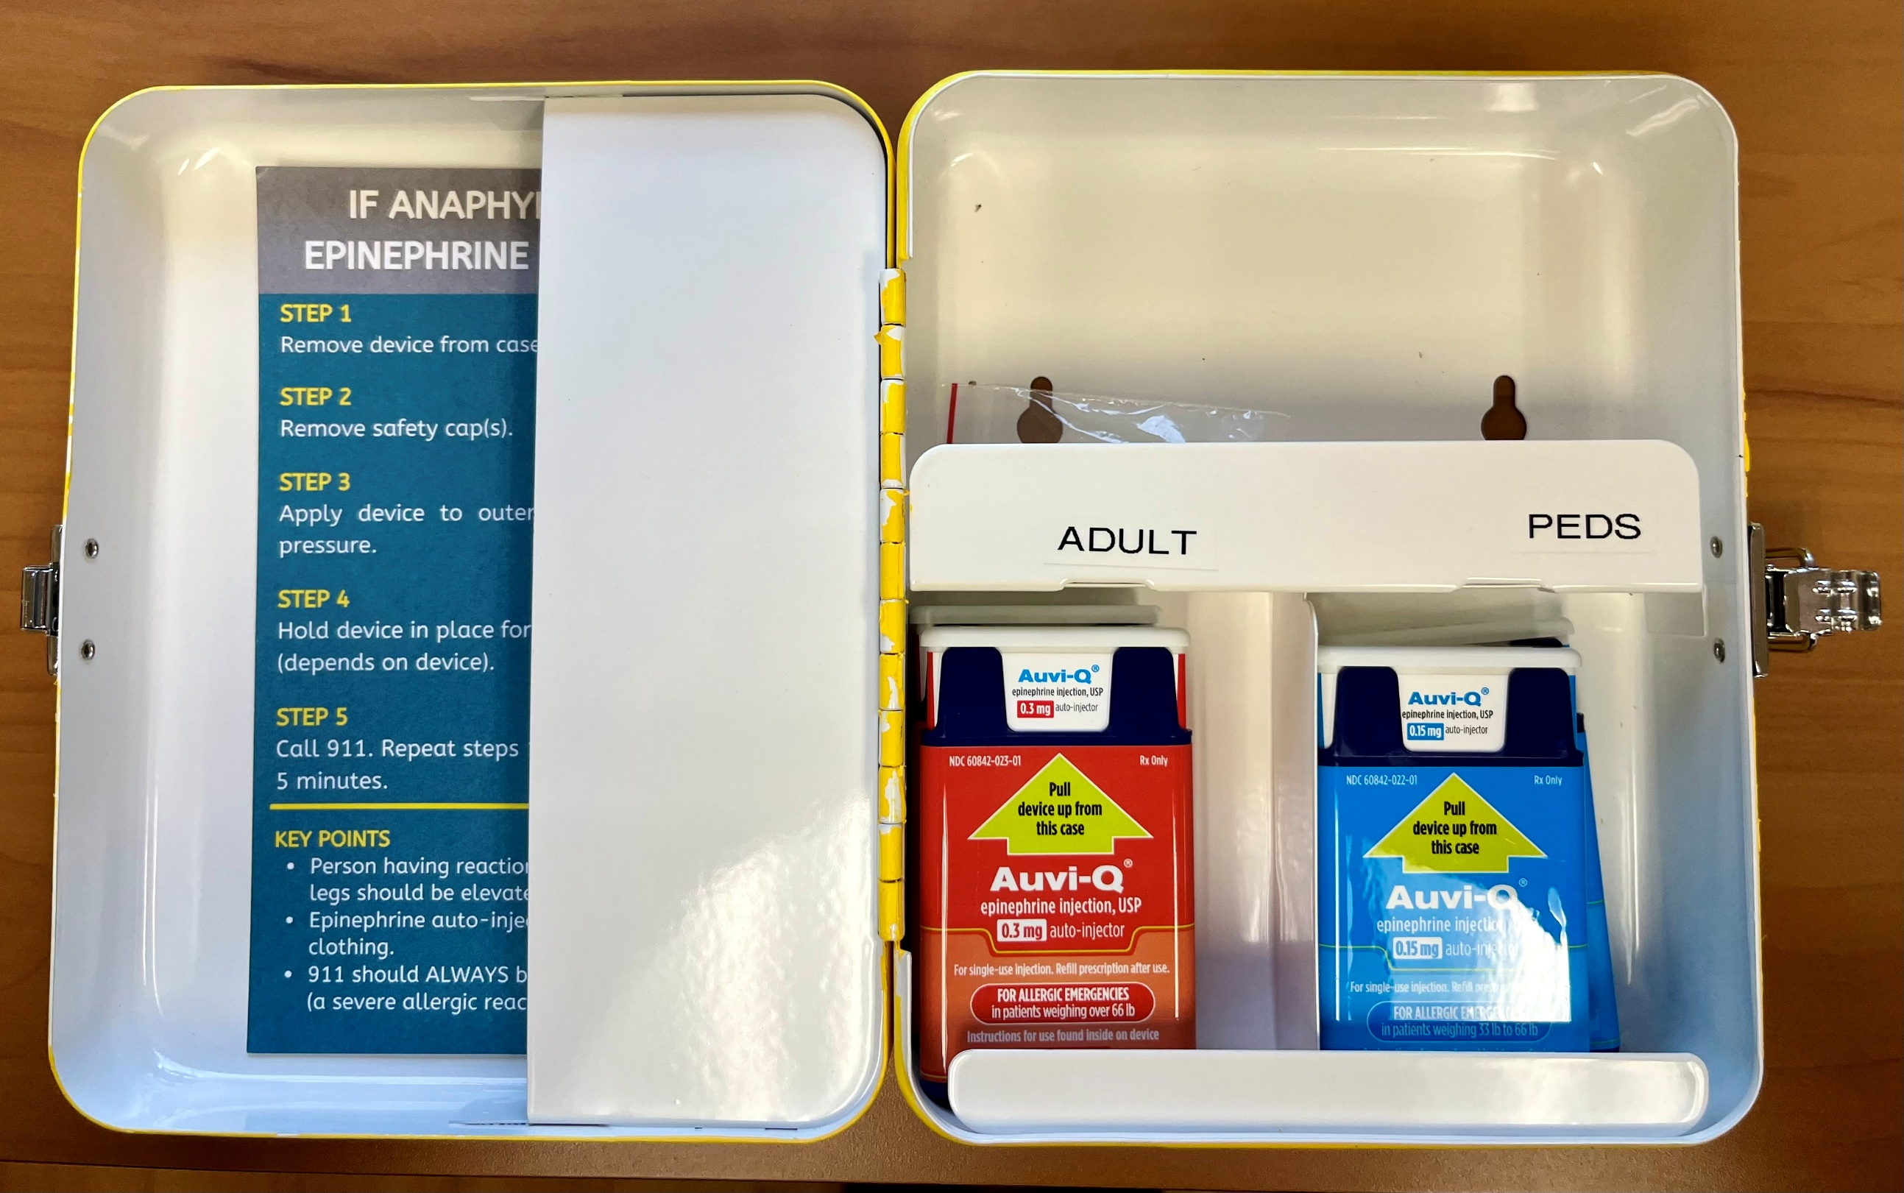
Allergy Emergency Kit

Slide 40





Not To Be Defined
Serena Williams
Peanut Allergy
Tommy Edman
Peanut Allergy
Malia Obama
Peanut Allergy
Mike Tirico
Nut Allergy
Ariana Grande
Shellfish Allergy

Slide 41
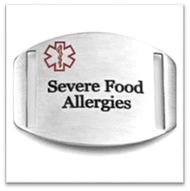
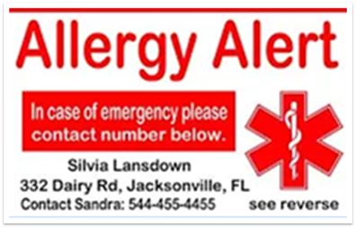
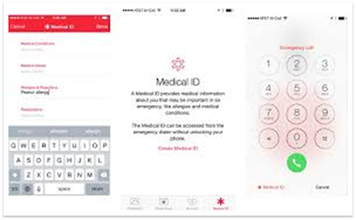
Medical Alert Identification
Jewelry
Identification Card
Smart Phone

Slide 42


Slide 43
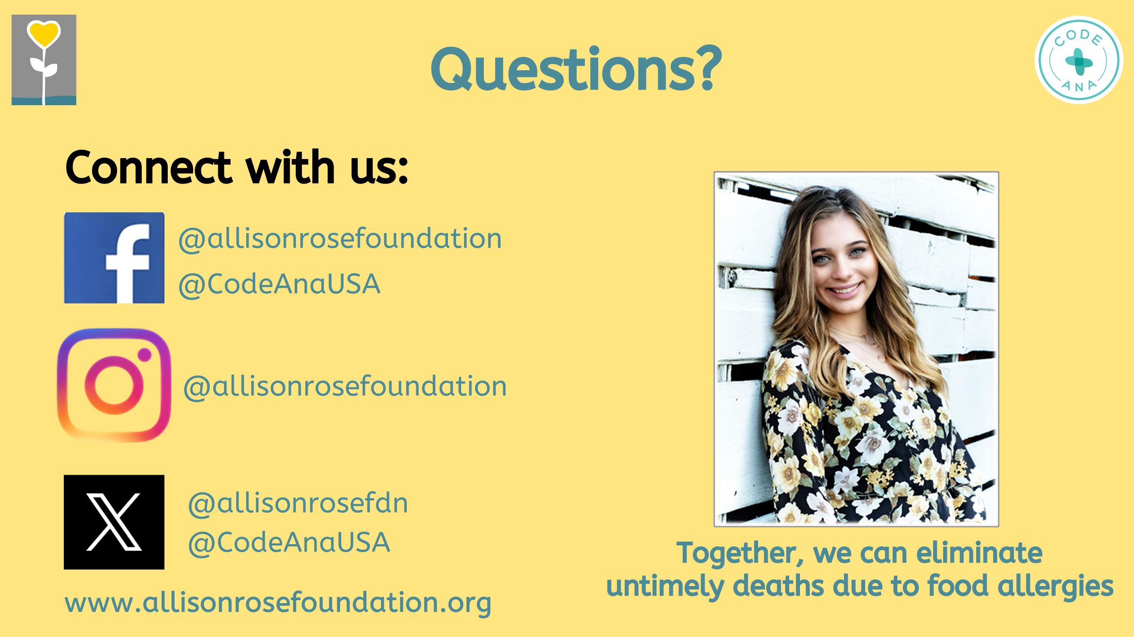




Questions?
Connect with us:
@allisonrosefoundation
@CodeAnaUSA
@allisonrosefoundation
@allisonrosefdn
@CodeAnaUSA
Together, we can eliminate
untimely deaths due to food allergies

