Slide 1

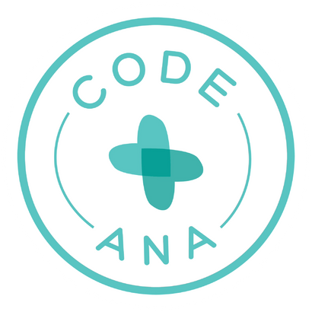
Food Allergy Training
The Ultimate Overview
for Food Services

Slide 2


Meet Ally
Allison Rose Suhy

Slide 3











Medical Advisory Board
Dr. Lisa Bartnikus
Boston Children’s Hospital
Dr. Ruchi Gupta
Lurie Children’s Hospital
Dr. Alice Hoyt
Coda Ana
Dr. Sandra Hong
Cleveland Clinic
Dr. Katie Marks-Cogan
Clear Allergy
Dr. Princess Ogbogu
University Hospital
Dr. Brian Schroer
Cleveland Clinic
Dr. Ruchi Shah
Cleveland Clinic
Dr. Julie Sterbank
MetroHealth
Dr. David Stukus
Nationwide Children’s Hospital

Slide 4
Code Ana
•This training was developed in collaboration with Code Ana.
•Code Ana is a non-profit program designed by board-certified, allergist Dr. Alice Hoyt.
•Code Ana equips schools to be prepared for medical emergencies like anaphylaxis through evidence-based medical information and innovative, school-tailored medical response planning.
•Code Ana developed our allergist driven train the trainer program for our medical professionals.
DISCLAIMER: The information provided here is for educational purposes only and is not intended to replace the medical advice of a doctor or healthcare provider. If you think you are observing a medical emergency such as but not limited to a food allergic reaction, call 911 immediately.

Slide 5
Key Points
  Anaphylaxis is a severe allergic reaction, and recognition is the first step to an effective response.
  Anaphylaxis is treated with epinephrine (Epi Pen, Auvi-Q, Neffy).
  This training will help prevent and prepare you for anaphylaxis.

Slide 6
An Epidemic
• More than 33 million Americans live with food allergies.
• 1 in 10 adults in the U.S. live with a food allergy.
• Restaurants are the second most common location for a food allergic reaction, and many individuals with food allergy do not freely share that they have food allergies.
• Not recognizing a food allergy reaction—delaying treatment—is a risk factor for death.
• Teenagers and young adults with food allergies are at the highest risk of fatal food-induced allergic reactions.

Slide 7
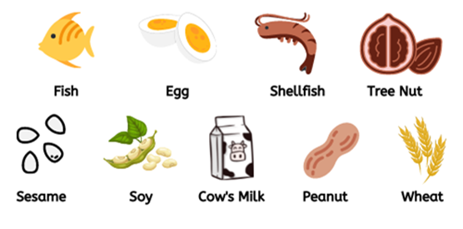
Allergy? Or Intolerance?
Sudden-Onset Hives, Swelling,
Trouble Breathing, Vomiting?
Likely Food Allergy

Slide 8


Allergy? Or Intolerance?
Sudden-Onset Hives, Swelling,
Trouble Breathing, Vomiting?
Headache, Bloating,
Fatigue, Brain Fog?
Likely Food Allergy
Likely Food Intolerance

Slide 9
Allergy? Or Intolerance?
Sudden-Onset Hives, Swelling,
Trouble Breathing, Vomiting?
Headache, Bloating,
Fatigue, Brain Fog?
Likely Food Allergy
Likely Food Intolerance
Key Differences
1. Treatment: Food allergy reactions are treated with epinephrine. Food intolerances are treated with over-the-counter medications.
2. Severity: Food allergy reactions are life threatening. Food intolerances are uncomfortable but not life threatening.

Slide 10
What Really is Anaphylaxis?
  Anaphylaxis is a severe allergic reaction.
  Anaphylaxis may start as “just hives” but then progress to involve breathing trouble and even death.
  Anaphylaxis should be treated promptly with epinephrine.

Slide 11

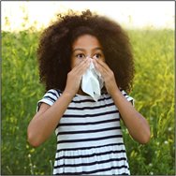

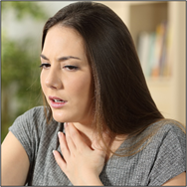

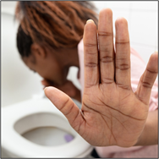
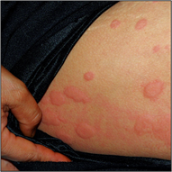
Symptoms of Anaphylaxis
Altered mental status
Feeling Faint
Loss of Consciousness
(due to low blood pressure)
Sudden-onset upper
respiratory congestion
Sneezing
Coughing
Trouble breathing
Wheezing
Swelling anywhere
especially face
Sudden-onset
Nausea/upset stomach
Vomiting
Diarrhea
Hives anywhere on
body

Slide 12
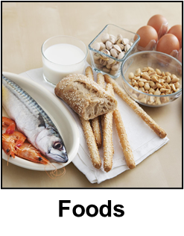
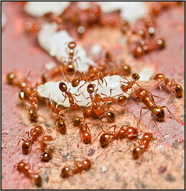

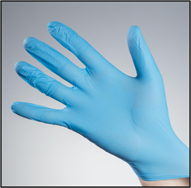


Causes of Anaphylaxis
Foods
Venomous Insects
Latex
Medications
Exercise

Slide 13
Treatment for Anaphylaxis
EPINEPHRINE
Epinephrine is the only medication that STOPS the allergic reaction.
Antihistamines (i.e. Benadryl) do NOT STOP the allergic reaction.

Slide 14
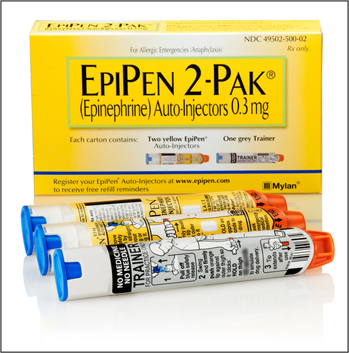
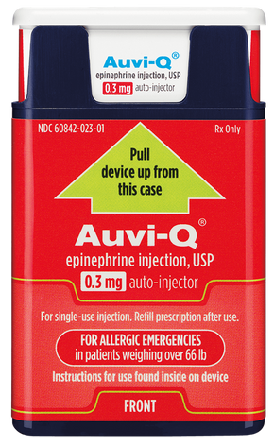
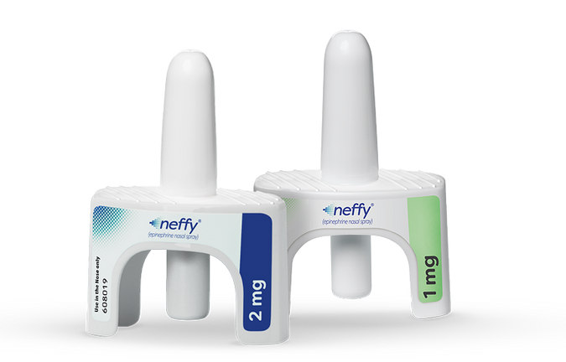
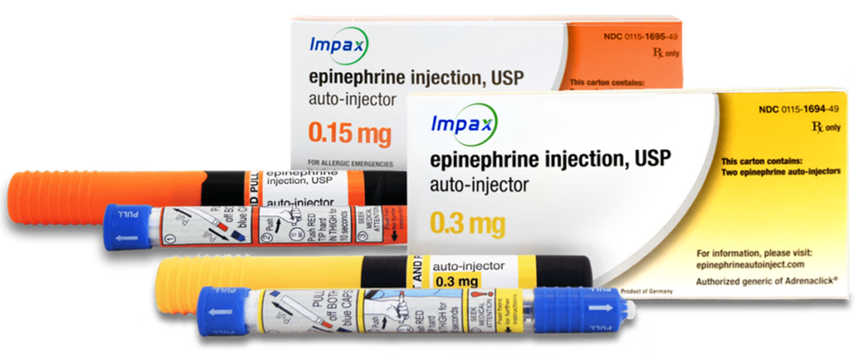
Epinephrine Devices
Auto-Injectors
Nasal Spray

Slide 15
How To Use an
Epinephrine Auto-Injector
Step 1: Remove device from case.
Step 2: Remove safety cap(s).
Step 3: Apply device to upper outer thigh, then apply firm pressure.
Step 4: Hold device in place for 2-10 seconds (depends on device).
Step 5: Call 911. Repeat 1-4 if no improvement in 3-5 minutes.
Key Points
1. Person having reaction should lay down. Ideally, legs should be elevated.
2. Epinephrine auto-injectors can be given THROUGH clothing.
3. 911 should ALWAYS be called when epinephrine is administered.

Slide 16
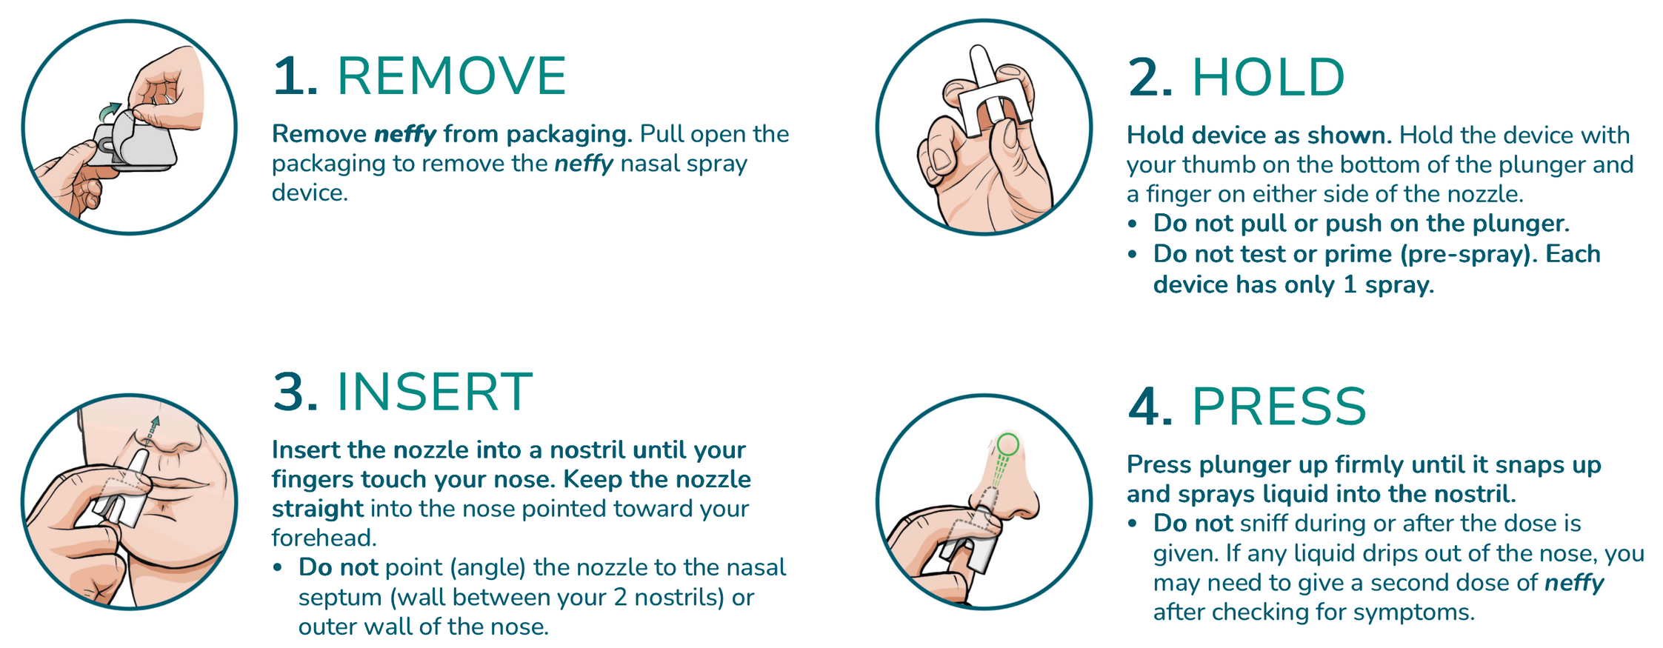
How To Use an
Epinephrine Nasal Spray

Slide 17
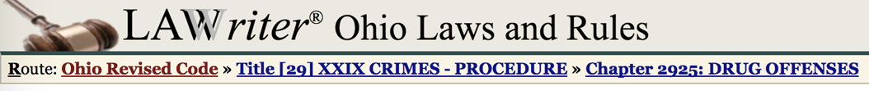
Law in Ohio
2925.64 Immunity for administering epinephrine.
(A) As used in this section:
(1) "Administer epinephrine" means to inject an individual with epinephrine using an autoinjector in a manufactured dosage form.
(2) "Prescriber" and "qualified entity" have the same meanings as in section 3728.01 of the Revised Code.
(B) An individual or qualified entity is not subject to criminal prosecution for a violation of section 4731.41 of the Revised Code or criminal prosecution under this chapter if the individual or entity, acting in good faith and in accordance with Chapter 3728. of the Revised Code, administers epinephrine or provides an epinephrine autoinjector to an individual who appears to be experiencing or at risk of experiencing anaphylaxis or to the parent, guardian, or custodian of such an individual.

Slide 18
COMMON QUESTIONS

Slide 19
Risk of Death
Which of the following increases the risk of death due to anaphylaxis?
A. Delayed administration of epinephrine
B. Asthma
C. Being a young adult
D. Type of food allergen
E. All of the above

Slide 20
Risk of Death
Which of the following increases the risk of death due to anaphylaxis?
A. Delayed administration of epinephrine
B. Asthma
C. Being a young adult
D. Type of food allergen
E. All of the above
A-D are associated with increased risk of BAD OUTCOMES.
A: Delaying treatment = worsening reaction = more difficult to treat.
B: Asthma attacks can be triggered by anaphylaxis and, because this involves the airway, is more likely to result in death.
C: Young adults may not always make ideal choices, but they also have robust immune systems that, when activated, can be difficult to stop. Also, alcohol and meds like Motrin (“NSAIDs”) increase the risk of anaphylaxis upon allergen exposure.
D: Some allergens, such as peanuts, are associated with death more so than other allergens.

Slide 21
Other Treatments
Which of the following are treatments for anaphylaxis?
A. Taking a cold drink of water
B. Taking deep breaths
C. Going outside into fresh air
D. Antihistamines, like Benadryl
E. Blowing cold air on their face
F. Cough medicine
G. “Sucking it up”
H. None of the above

Slide 22
Other Treatments
Which of the following are treatments for anaphylaxis?
A. Taking a cold drink of water
B. Taking deep breaths
C. Going outside into fresh air
D. Antihistamines, like Benadryl
E. Blowing cold air on their face
F. Cough medicine
G. “Sucking it up”
H. None of the above
•Epinephrine, not antihistamines, treat the signs and symptoms of anaphylaxis.
•A-G do not and relying on treatment options A-G will result in DELAYED administration of epinephrine, which results in WORSE outcomes.

Slide 23
True or False

Slide 24
Benadryl
True or false: Benadryl is a treatment for anaphylaxis.
A. True
B. False

Slide 25
Benadryl
True or false: Benadryl is a treatment for anaphylaxis.
A. True
B. False
• Benadryl does not stop allergy cells from releasing the chemicals that cause the symptoms of anaphylaxis.
• Only epinephrine stops allergy cells.
• Benadryl also does not help fix low blood pressure or trouble breathing. Epinephrine DOES.

Slide 26
One Bite
True or false: One bite of an allergen could be fatal.
A. True
B. False

Slide 27
One Bite
True or false: One bite of an allergen could be fatal.
A. True
B. False
• Even microgram amounts of allergens can cause fatal reactions.
• If a person is allergic, strict avoidance is important.

Slide 28
Proximity
True or false: A person with a food allergy cannot be in the same room with his/her allergen because close proximity even without eating it could cause an anaphylactic reaction.
A. True
B. False

Slide 29
Proximity
True or false: A person with a food allergy cannot be in the same room with his/her allergen because close proximity even without eating it could cause an anaphylactic reaction.
A. True
B. False
•Allergic reactions to foods are triggered when a person with the food allergy eats - “ingests” the food to which s/he is allergic.
•Looking at the food will not cause an allergic reaction.
•Smelling the food will not cause an allergic reaction.

Slide 30
Epinephrine #1
True or false: An individual who is trained in how to administer epinephrine and who, in good faith, recognizes and treats anaphylaxis with epinephrine, may be held liable if there is a bad outcome.
A. True
B. False

Slide 31
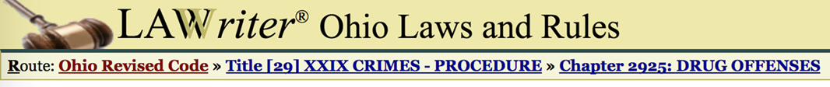
Epinephrine #1
True or false: An individual who is trained in how to administer epinephrine and who, in good faith, recognizes and treats anaphylaxis with epinephrine, may be held liable if there is a bad outcome.
A. True
B. False
An individual or qualified entity is not subject to criminal prosecution for a violation of section 4731.41 of the Revised Code or criminal prosecution under this chapter if the individual or entity, acting in good faith and in accordance with Chapter 3728. of the Revised Code, administers epinephrine

Slide 32
Epinephrine #2
True or false: If epinephrine is used, call 9-1-1.
A. True
B. False

Slide 33
Epinephrine #2
True or false: If epinephrine is used, call 9-1-1.
A. True
B. False
•Epinephrine treats the life-threatening reaction ANAPHYLAXIS. Multiple doses may be required.
•ANAPHYLAXIS is dangerous and requires immediate medical attention, even if symptoms are improving.
•A person experiencing anaphylaxis needs to be treated with epinephrine and call 9-1-1, not because epinephrine is dangerous (it is not) but because anaphylaxis is dangerous.

Slide 34
Epinephrine #3
True or false: Epinephrine should only be administered for anaphylaxis in a person with a known diagnosis of food allergy.
A. True
B. False

Slide 35
Epinephrine #3
True or false: Epinephrine should only be administered for anaphylaxis in a person with a known diagnosis of food allergy.
A. True
B. False
• Many individuals do not readily share their food allergy status.
• Only about half of the customers who had a reaction (53.9 percent) informed restaurant staff beforehand about the allergy.
• Epinephrine is very safe!

Slide 36
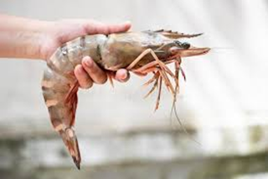
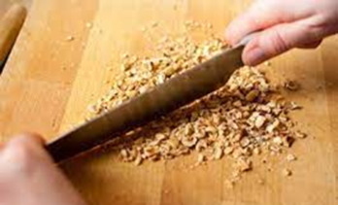
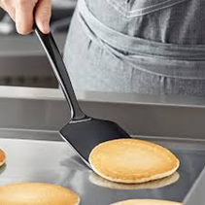
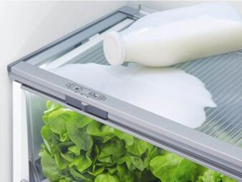

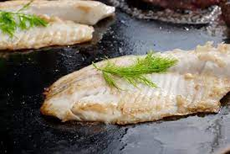
What is Cross Contact?
Cross-contact occurs when one food comes into contact with another food. These amounts can be so small that they may not be seen. Sources include:
Hands
Cutting Boards/Surfaces
Utensils
Refrigerator/Storage Area
Condiments/Containers
Cooking Surfaces

Slide 37
Cross Contact
WAYS TO AVOID CROSS CONTACT:
•Cook allergy safe meal first, use allergy safe utensils
•Prepare meals on top of barriers like cutting boards, foil or deli paper
•Keep safe food away (cover) because other foods may splatter
•If a mistake is made you cannot just remove the allergen, microgram amount can be fatal
•Wash hands (change gloves), cookware and utensils with soap and water. Sanitizing gels or just water will not remove the allergens

Slide 38
Be Prepared
Discuss risks for exposure
  Cross-contact
    Sharing utensils and drinks
  Dating/Kissing
Ask and tell about prior reactions
Know who in your circle of friends or co-workers are at risk for food allergy emergencies
Emergency action plan
  Epi
  911
  Supportive care

Slide 39
Communication with Guests
•ASK ABOUT FOOD ALLERGIES
•Document the guest’s allergy to “record the conversation”.
  If you have questions, ask the guest.
  TAKE ALL FOOD ALLERGY REQUESTS SERIOUSLY.
•Refer the allergy to the chef, manager or person in charge.
•Get it there safely. Explain the process to the guest.
  Double check with the chef to make sure you have the right meal. Don’t let anyone add garnishes. Carry the special meal to the table separately.

Slide 40
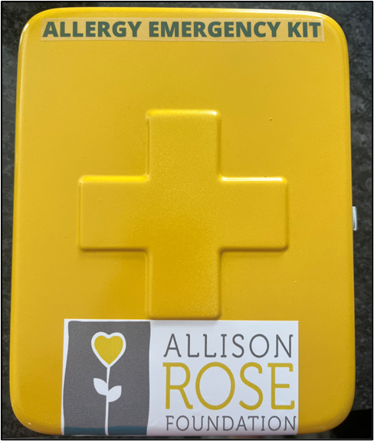
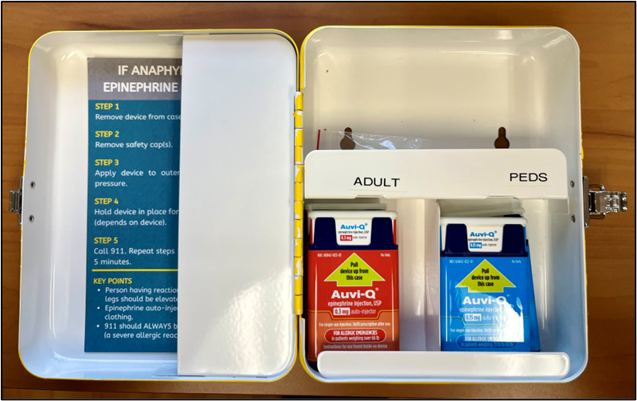
EPI Storage Box

Slide 41
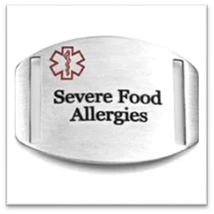
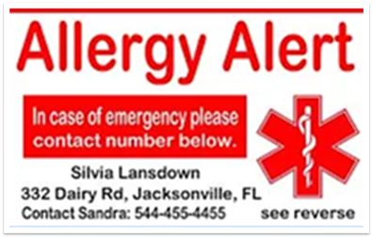
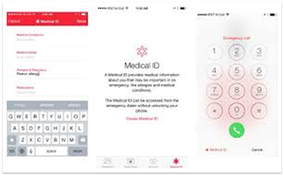
Medical Alert Identification
Jewelry
Identification Card
Smart Phone

Slide 42


Slide 43




Questions?
Connect with us:
@allisonrosefoundation
@CodeAnaUSA
@allisonrosefoundation
@allisonrosefdn
@CodeAnaUSA
Together, we can eliminate
untimely deaths due to food allergies

